Slide 1

Affluence of taxis to Beijing’s points of interest
77013 - Diego Hernandez
77076 - Rodrigo Pereira

Slide 2
Case Study
Is there any differences in affluences to certain points of interest along the day and/or week?
This is the research question we decided to study with the data provided in the class.
It is specially interesting because the time frame of the data provided coincides with the week of the chinese new year
Notes:
Is there any differences in affluences to certain points of interest along the day and/or week?
This is the research question we decided to study with the data provided in the class.
It is specially interesting because the time frame of the data provided coincides with the week of the chinese new year

Slide 3
Case Study
Religious places are popular at the time ?
Is there any differences in affluences to certain points of interest along the day and/or week?
Affluence to touristic places varies during the week
Notes:
Is there any differences in affluences to certain points of interest along the day and/or week?
This is the research question we decided to study with the data provided in the class.
It is specially interesting because the time frame of the data provided coincides with the week of the chinese new year

Slide 4
Methodology

Slide 5
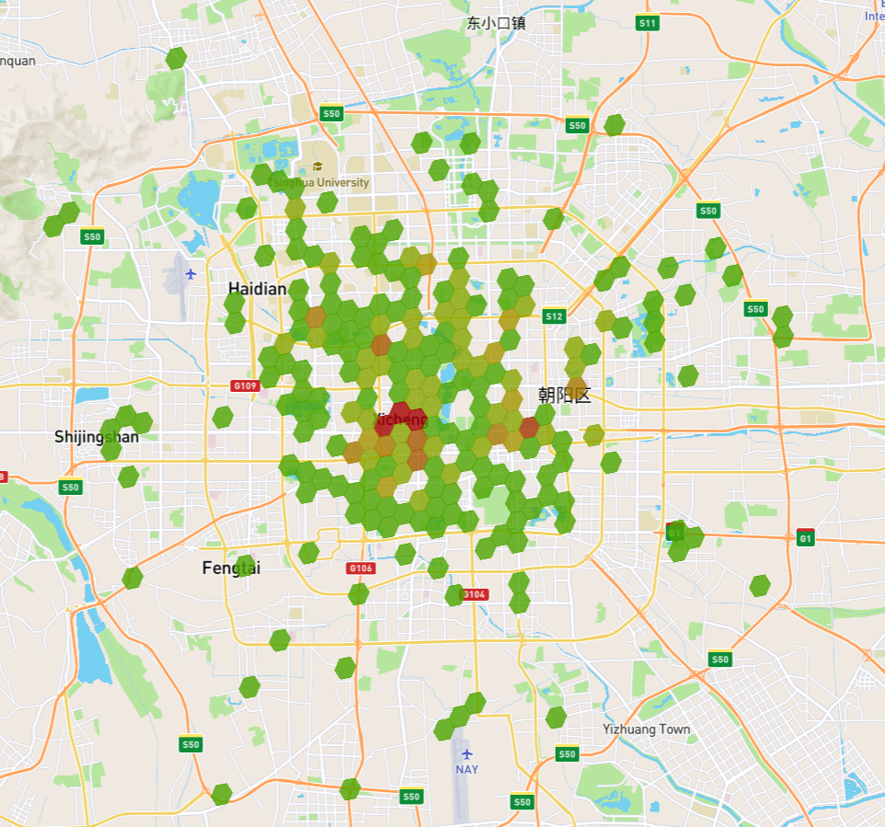
Approach to the problem
Since we wanted to work with counts of taxis near location, we decided that the best way to capture that concept was to divide the city of Beijing in small areas that would only contain a handful of locations and count the number of taxis at a certain point in time.
To tackle this problem we decided to use UBER’s library “H3”, that divides the globe into hexagons, with a parameterizable granularity (in our case we used hexagons that cover a city block).

Slide 6
Approach to the problem
Divide the city of Beijing into small areas using Uber’s H3 library
Obtaining the number of taxis on the areas that contains the location we want to study
Analyze results by types of point of interest
Notes:
Since we wanted to work with counts of taxis near location, we decided that the best way to capture that concept was to divide the city of Beijing in small areas that would only contain a handful of locations and count the number of taxis at a certain point in time.
To tackle this problem we decided to use UBER’s library “H3”, that divides the globe into hexagons, with a parameterizable granularity (in our case we used hexagons that cover a city block).

Slide 7
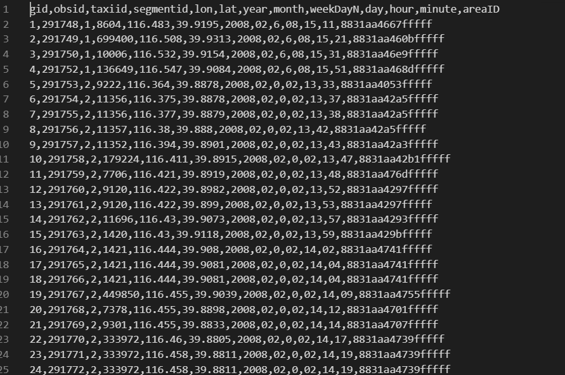
Pre processing
To achieve our goals we need to add additional information to the one provided.
For that purpose we mapped the coordinates of the given taxi to an H3 area, using the method geoToH3(lat,long,zoom)
We additionally restructured the given timestamps to include information about the day of the week.

Slide 8
Pre processing
Add additional H3’s AreaID to given data;
Add information about day of the week to given data;
Notes:
To achieve our goals we need to add additional information to the one provided. For that purpose we mapped the coordinates of the given taxi to an H3 area, using the method geoToH3(lat,long,zoom). We additionally restructured the given timestamps to include information about the day of the week

Slide 9
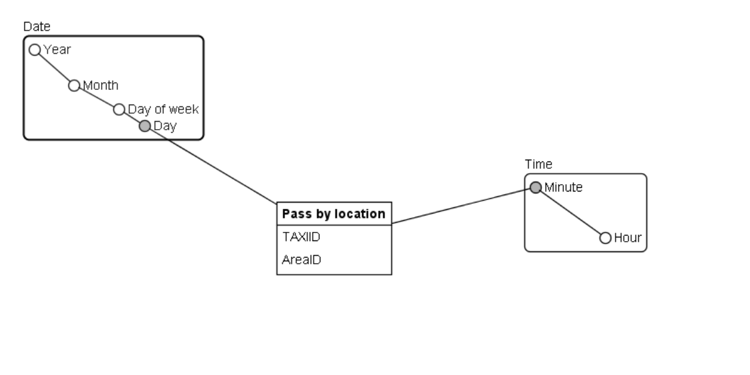
Temporary dimensional model
Necessity for temporary dimensional model to hold our csv data, that reflected the event of passing by an area.
Use of Microsoft SSIS tools to do it
Notes:
After the pre-processing, we had a csv, so we figured that we should translate that information to a dimensional model.For that purpose we used Microsoft’s SISS tool. And se we obtained an event data model, that translated the passage of a taxi in a certain area.

Slide 10
Temporary dimensional model
After the pre processing, we had a csv, so we figured that we should translate that information to a dimensional model.
For that we used Microsoft’s SISS tool.
An event model, that translates the passage of a taxi in a certain area.
Notes:
After the pre processing, we had a csv, so we figured that we should translate that information to a dimensional model.
For that we used Microsoft’s SISS tool.
An event model, that translates the passage of a taxi in a certain area.

Slide 11
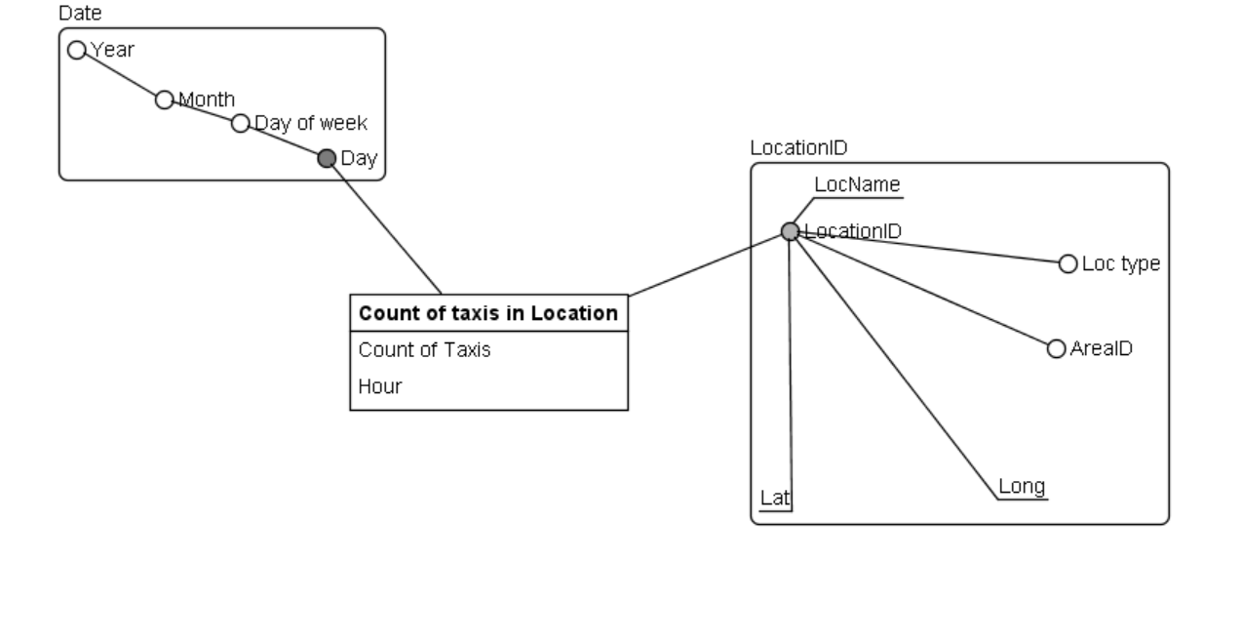
Definitive Dimensional Model
Use google’s API to gather Points of interests and their types
Join point of interest data with the the one stored in ou temporary data model to get data mart that could give us counts of taxis by hour on different locations
Notes:
To gather our points of interest we made use of the Google Map’s API, in order to obtain a list of these points, with their respective coordinates, their types and their names. And mapped them to our H3 areas
We then joined this data to the data present on our “temporary” dimensional model to generate the final dimensional model that would be able to answer our questions.

Slide 12
Definitive Dimensional Model
To gather our points of interest we made use of the google’s API, to get a list of these points, with their coordinates, their types and their names. The following were mapped to the respective H3 areas.
We then joined this data to the data present on our “temporary” dimensional model. To generate the final dimensional model that was going to be able to answer our questions
Notes:
To gather our points of interest we made use of the google’s api, to get a list of these points, with their coordinates, their types and their names. And mapped them to our H3 areas
We then joined this data to the data present on our “temporary” dimensional model. To generate the final dimensional model that was going to be able to answer ou questions

Slide 13
Analysis

Slide 14
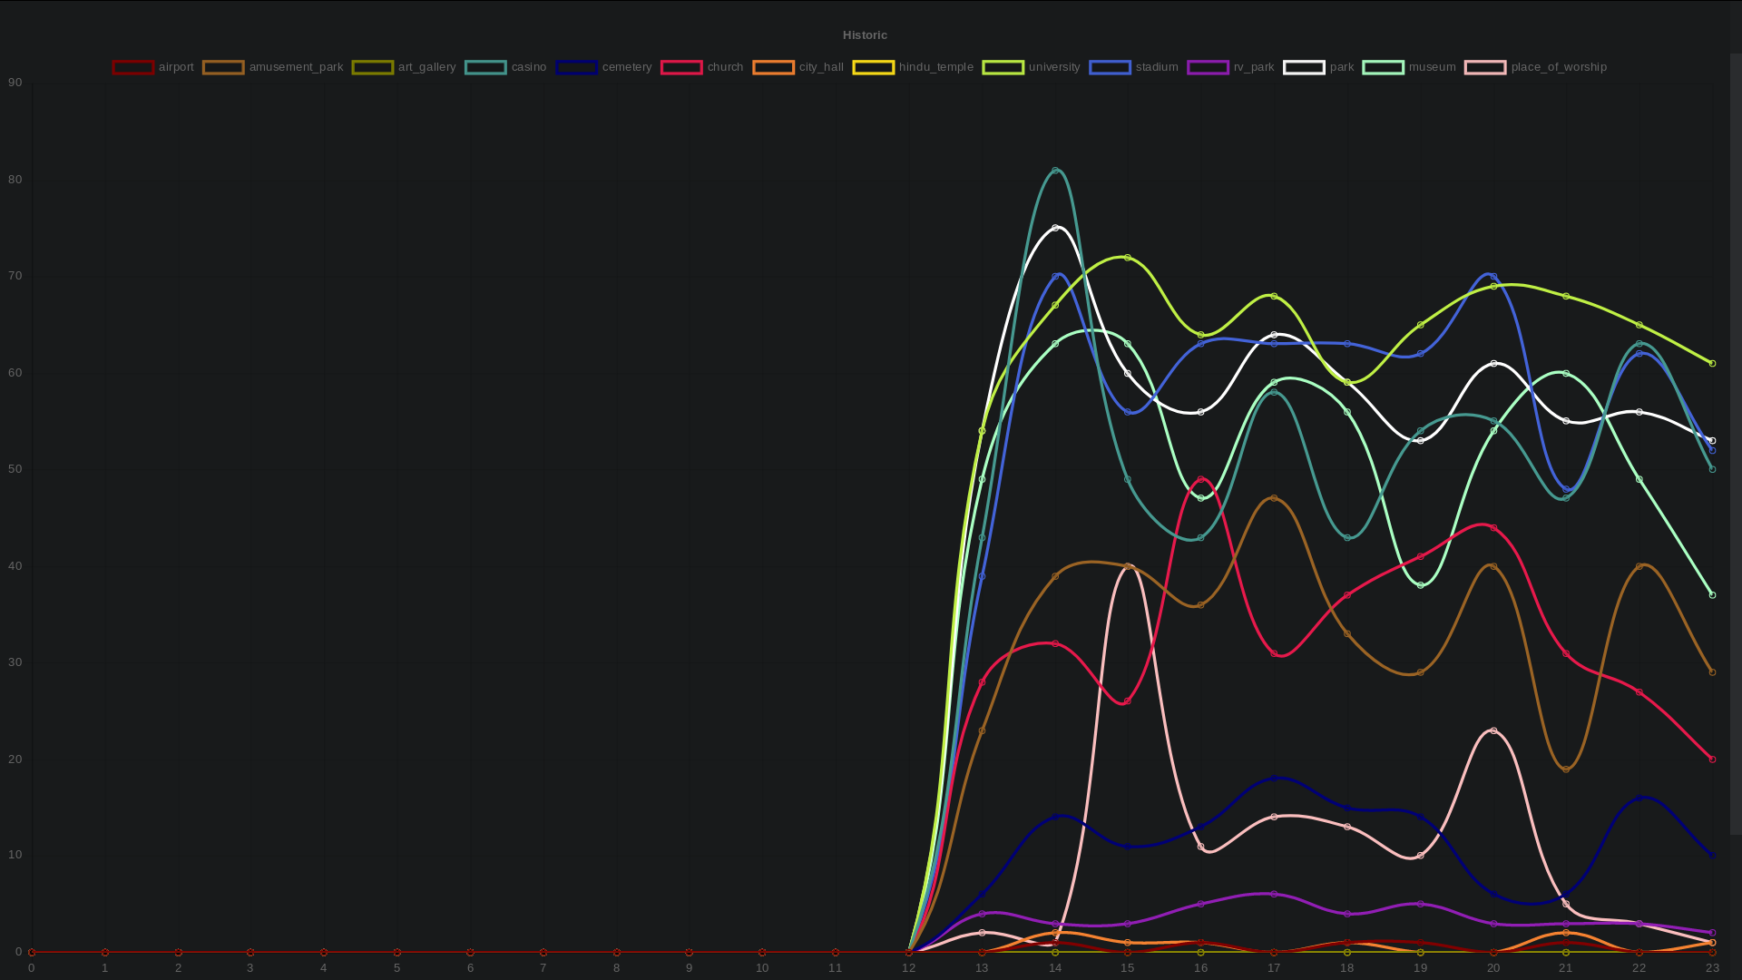
Saturday

Slide 15
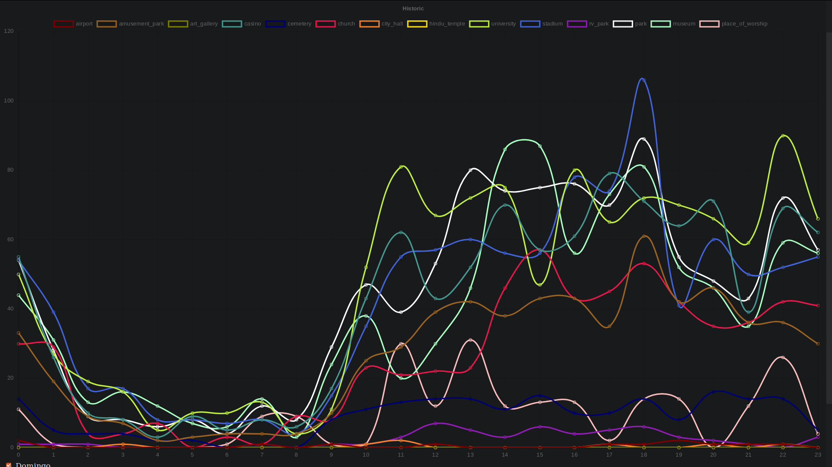
Sunday
Notes:
Low

Slide 16
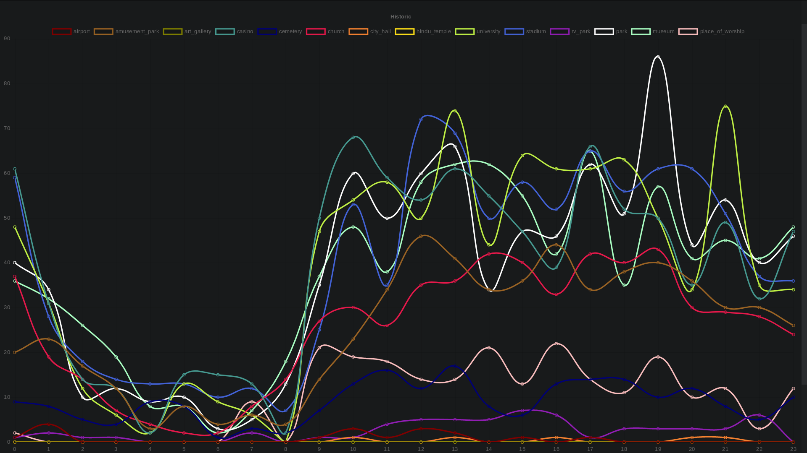
Monday

Slide 17
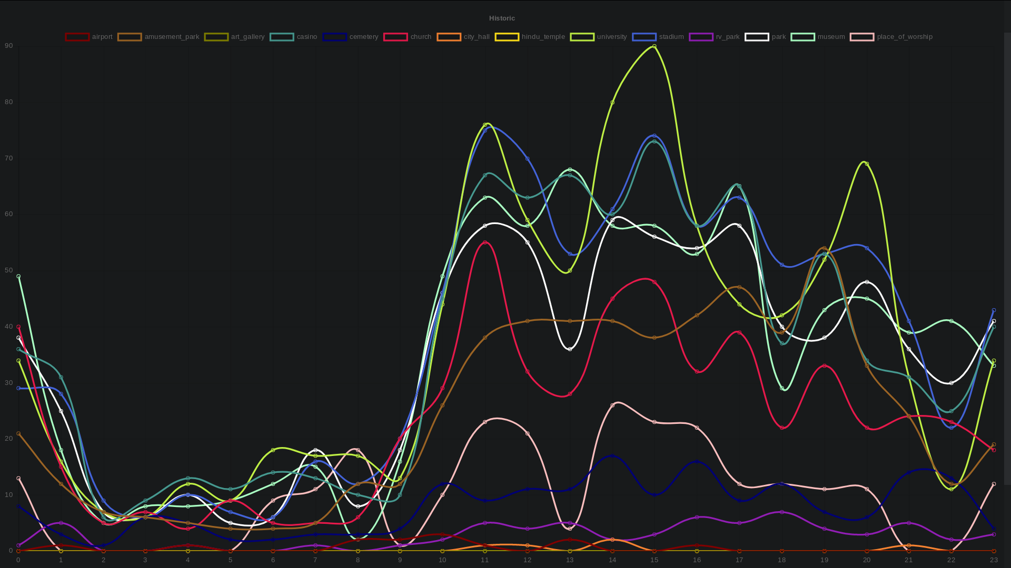
Thursday

Slide 18
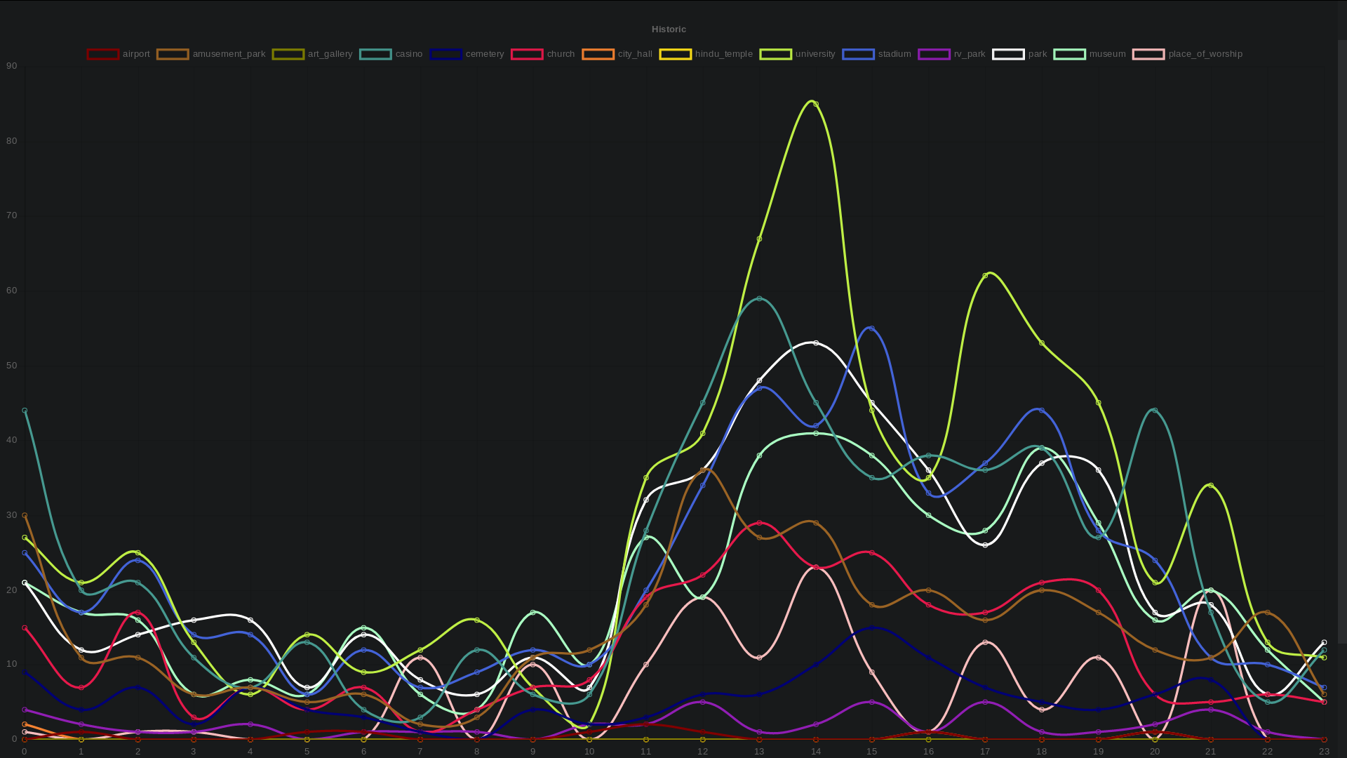
Wednesday

Slide 19
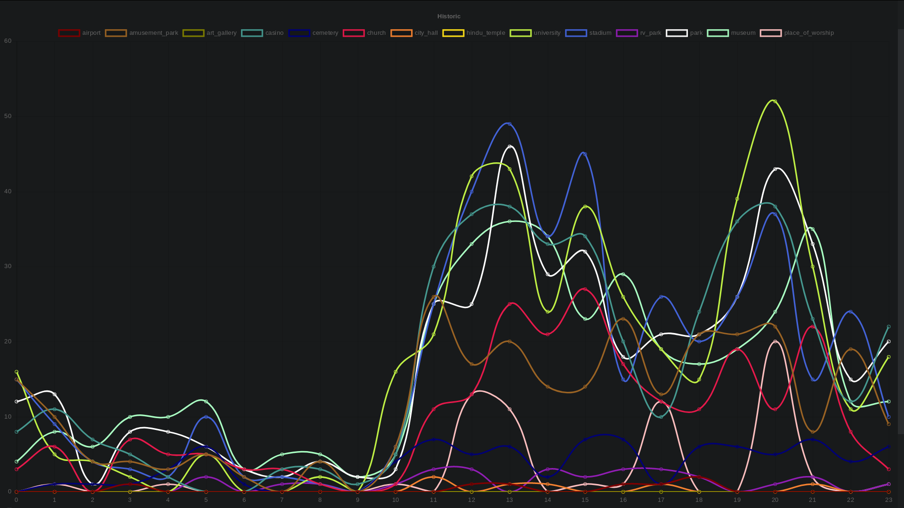
Tuesday - “Chinese new Year”

Slide 20
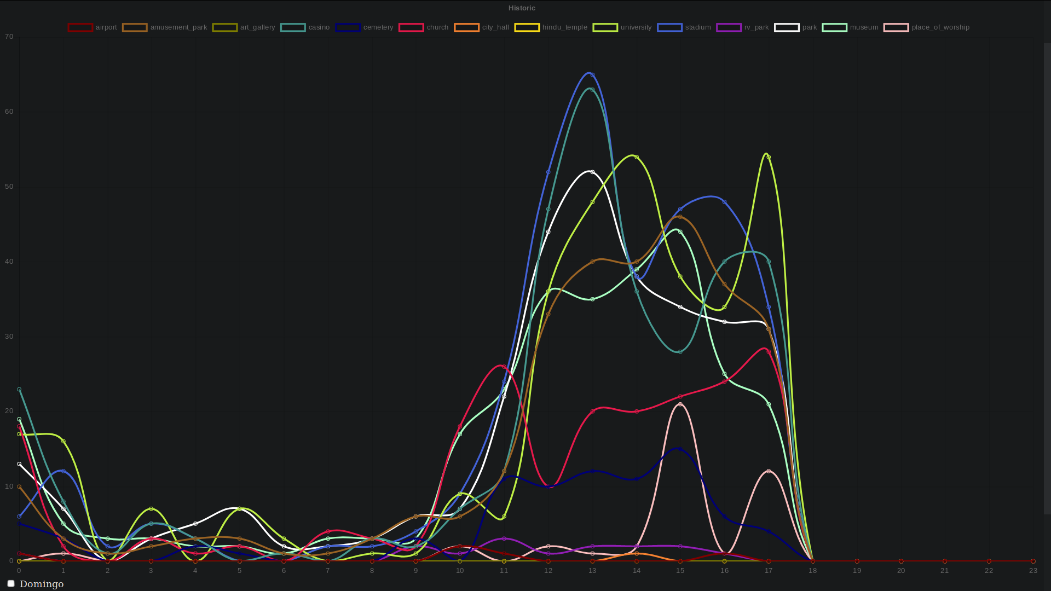
Friday

Slide 21
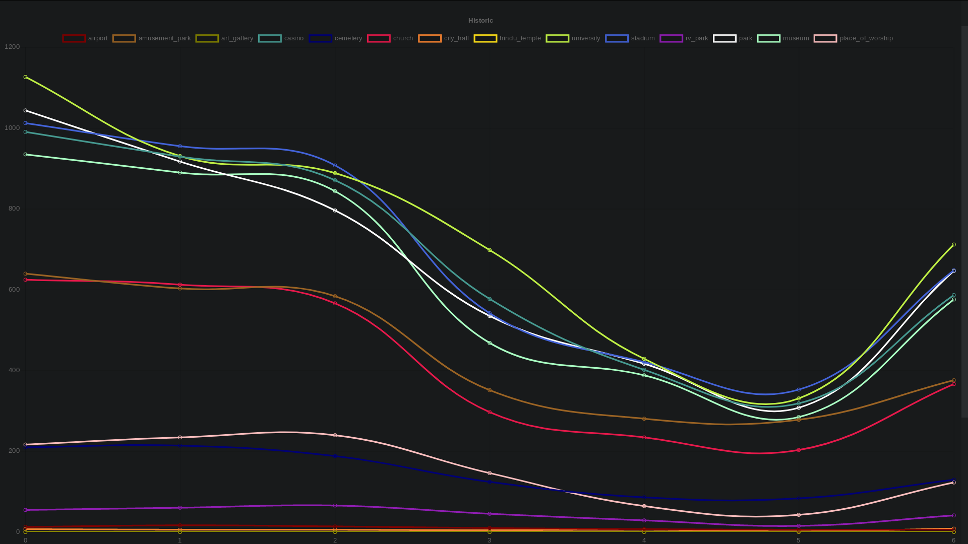
Total numbers during the week
Notes:
0 - Sunday, 6 -Saturday
We can see a valey arround the chinese new year

Slide 22
Affluence to different types of POIs
One aspect that is obvious looking at the data is that it starts being read at 12 PM of 2 February (Saturday) and stops being read adt 6 PM of 8 February (Friday);
The late night hours are the hours with less taxis circulating overall (despite existing some with still some affluence like casinos)
The type of locations with more taxi affluence near them are overall universities (probably due to an elevate concentration of them, 65 in total, 34 unique areas with at least one)
The data shows a relevant dip in the total number of taxis near points of interest around the time of the start of the chinese new year (tuesday), probably since its a day where most people stay at home with family
Despite having small variances on the affluences of the different types, it does seem to follow a pattern along the week

Slide 23
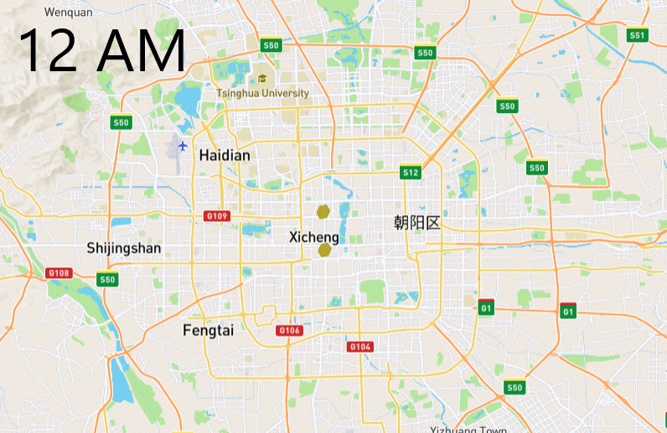
Affluence to Universities during the day
Notes:
Since Universities where the places with most affluence we decided to observe their affluence during the day to see if we could notice some pattern.
We noticed that the affluence is more concentrated on universities near the center of the city (less on the universities on the outskirts, with a slight exception for Tsinghua University that still has some affluence despite being on the outskirts, mainly due to being the 1st ranked University on asia [https://www.timeshighereducation.com/world-university-rankings/tsinghua-university#survey-answer])

Slide 24
Conclusions
Our hypothesis was partially supported by the data obtained and we can still infer some more interesting facts about it, some of those can be interesting especially to the taxi industry. The most obvious one is the points of interest with most affluence, what can help taxists better decide on places to search for passengers.

